Slide 1
Technical Communication

Slide 2

Lead-in
Suppose you’re going to graduate from university and hunt for a job, what should you have to get ready in advance?
Résumé
Job application letter/cover letter
Photocopies of Certificates
Academic record/transcript
Recommendation form/letter
What can help the prospective employer to shortlist the candidates to be considered?
A well-prepared résumé
Notes:
http://www.professional-business-writing.com/

Slide 3
Writing Résumés
Notes:
A resume is a self-advertisement that, when done properly, shows how your skills, experience, and achievements match the requirements of the job you want.

Slide 4
1
Résumé vs. Curriculum Vitae
2
Preparation for a Résumé
3
Types of Résumés
目 录
CONTENTS
4
Résumé Design and Structure
5
Element in a Résumé
6
Questions for Review
Notes:
curriculum vitae英[kəˌrɪkjələm ˈvi:taɪ]

Slide 5
Résumé vs. Curriculum Vitae
 | Résumé | Curriculum Vitae (CV)
Content
Length
education, past employment, skills for the new position
all the elements of a résumé but more detailed in terms of the academic credentials
the number of conferences attended, number of papers published, a brief summary of projects carried out
a detailed account of all the papers published, papers presented at the conferences, and research projects carried out
usu. 1 page
sometimes 2 pages
more than 2 pages
up to tens of pages

Slide 6
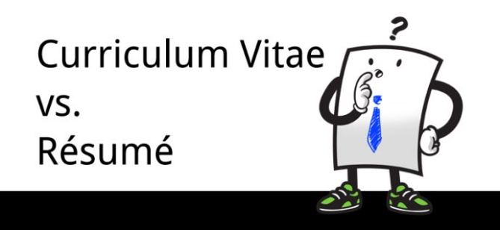
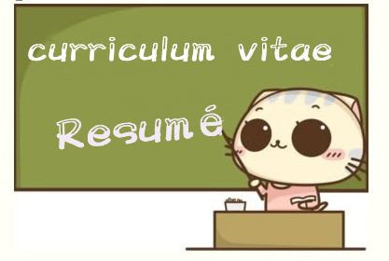
 | Résumé | Curriculum Vitae (CV)
Target
Feature
for any position in an organization
for a position in a research organization
more skill-oriented
more knowledge-oriented
Résumé is suitable for almost all types of organizations.
Résumé can be modified according to the skill sets required by a particular job.
Personal information such as age, date of birth, marital status, nationality, and gender are generally not included in a résumé.

Slide 7
Preparation made for a Résumé
What should we do before writing a résumé?
Know ourselves (our selling points)
Know the target company/employer
Know the target post
Education (degrees earned)
Work experience (skills gained)
Activities attended
Awards received
Personality traits
Interests and hobbies
3 knows
Development and prospect
Management and operation
Enterprise culture and value
Products or services
Needs and problems
Social image and status
Responsibilities
Requirements
Pay and benefits
Chances for promotion

Slide 8

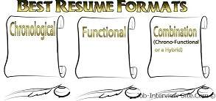
Types of Résumés
Chronological résumé
Functional/skills résumé
Hybrid/combination résumé

Slide 9
Chronological résumé
Preferred by most employers
the most common way of organizing the information in a résumé
Emphasizes education and work experience
Is most effective when such experience clearly relates to the new job
List entries in reverse order, beginning with the most recent experience
Under each position listed under Work Experience, describe responsibilities handled and accomplishments, emphasizing relevant experience with the skill set required for the job

Slide 10
Functional/skills résumé
features the skills that the candidate has got
provides examples of the most significant experience that demonstrates these skills
emphasizes individual fields of competence
includes a separate section, usu. called “Skills” or “Skills and Abilities” that emphasizes job skills and knowledge.
Follow the Skills category immediately with a chronological Work History and a scaled-down Education section that lists only institutions, degrees, and dates.
Either of them may come first, depending on whether most of skills and experience were gained in college or on the job.
used by applicants who want to redirect their careers, or who have little continuous career-related experience

Slide 11

Hybrid/combination résumé
includes the best features of the chronological and functional résumés.
not popular or not commonly used as it tends to be very long and also it may turn out to be repetitive in nature.
Whatever the format, strong résumés possess the same qualities:
They focus on the employer’s needs.
They are concise.
They are honest.
What type of résumé do you think is usually used by a recent graduate?
chronological résumé
In most cases, they lack the record of skills and accomplishments needed for a skills résumé.

Slide 12
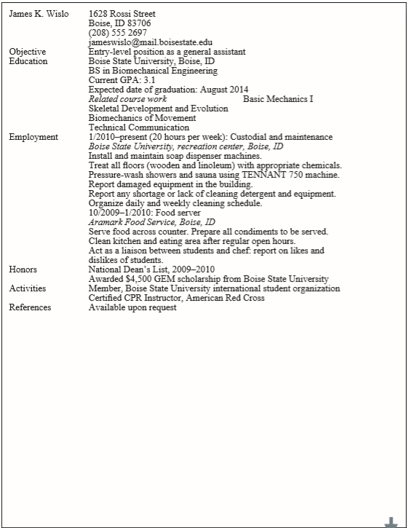
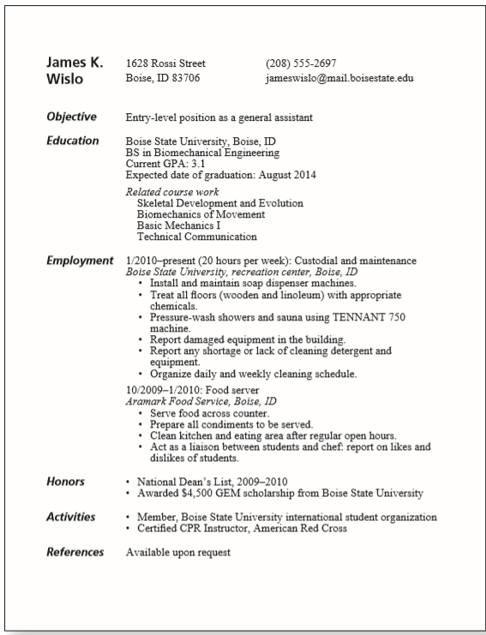
Résumé Design and Structure
Which one do you think is quite acceptable?
A résumé communicates in two ways:
through its content
through its appearance

Slide 13


Appearance of the Résumé
What is the main purpose of the résumé?
to gain the opportunity for an interview.
A résumé should appear neat and professional.
Generous margins.
Leave a one-inch margin on all fours sides
Clear type
Printed on good-quality paper of A-4 size
Reproduced clearly on a high-quality printer or photocopier
Balance
Arrange the information well to ensure a balanced appearance
Clear organization
Use adequate blank space
Indent appropriately

Slide 14
Clear organization
Use adequate blank space
The line spacing between items should be larger than the line spacing within an item.
There should be more space between sections than between items within the section.
Indent appropriately
When arranging items in a vertical list, indent turnovers, the second and subsequent lines of any item, a few spaces.

Slide 15
Content of the Résumé
Résumés must be informative and attractive.
The résumé must provide clear, specific information, without generalizations or self-congratulation.
The résumé is a sales document. The writer is both the salesperson and the product.
provide the reader with the details that will lead the reader to reach the conclusion about the writer.
The résumé must be free of errors.
Writing errors cast doubt on the accuracy of the information in the résumé as well as the competence of the writer.
Proofread the finished product at least twice, and then have someone else proofread it.

Slide 16

Elements in a Résumé
While résumés can be organized in more than one way, they will almost always contain the same basic information.
Identifying information (personal/contact information)
Objectives or summary of qualifications (Career/professional objective)
Education (Educational/academic qualifications)
Employment history (Work experience /Professional and technical skills)
Interests and activities (Extracurricular activities and achievements/special interests, aptitudes, memberships /Awards and honours )
References

Slide 17
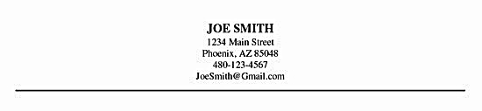
Personal information
The first thing an employer needs to know is who you are and where you can be reached.
Make sure that the information allows an interested employer to reach you easily.
Full name
All letters or initial letters are capitalized
Address
A permanent postal address should be provided.
Phone number Home or cell phone is preferable.
Email address
Ensure that it sounds professional rather than frivolous.

Slide 18
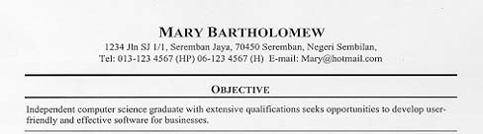
Objectives or summary of qualifications
(optional)
Most employers agree that a statement of professional objective should be included in a résumé.
Make it effective by being as specific as possible about the requirement or aspiration.

Slide 19
A statement of objectives. used most often by candidates new to the field, is a brief phrase or sentence.
Follow the following 3 suggestions:
State only the goals or duties explicitly mentioned, or clearly implied, in the job advertisement.
Focus on the reader’s needs, not on your goals.
“with opportunities for advancement” or “offers a high salary”
“Position in Software Engineering specializing in database applications development that enables me to use my four years of experience.”
Be specific.
“Position offering opportunities in the field of health science, where I can use my communication and analytical skills.”
Specify what kind of position you want

Slide 20
Read and Comment
No focus
Seeking employment in a business environment offering an opportunity for professional growth.
Too general
Comments?
Comments?
It specifies which job the applicant is seeking.
It also specifies how the applicant will benefit the company.
To market financial planning programs and provide financial counseling to ensure positive client relations.

Slide 21
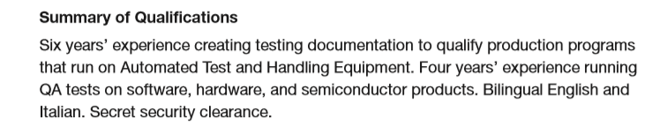
a summary of qualifications is usually used by job applicants with more experience.
A brief paragraph that highlights three or four important skills or accomplishments.

Slide 22
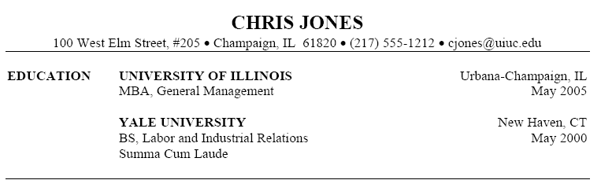
Educational/academic qualification
While applying for a job when one is about to graduate, educational qualification and experience are the highest selling points.
The degree earned + major and minor fields of study
The institution—identify it by its full name
The location of the institution. Include the city and state
The date of graduation—”Anticipated date of graduation”
Impressive GPA
Begin with the most recent education and work backward.

Slide 23

Practise writing
Write Education section of the résumé based on your own education experience.

Slide 24
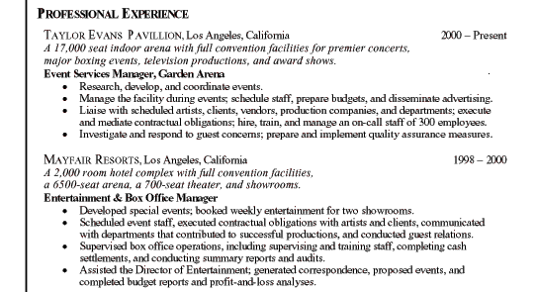
Work experience/professional skills
List jobs in reverse chronological order to highlight the most recent employment.
Include any part-time or summer internships or projects done.
Provide at least a two- to three-line description for each position.
Be sure to use very concrete language to describe the work experience.
Each entry includes
the organization’s name and location
the duration of work,
a brief summary of the work (optional)
the job title or position,
carefully selected accomplishments

Slide 25
For particularly important or relevant jobs, write more, focusing on one or more of the following factors:
Skills.
What technical skills did you use on the job?
Equipment.
What equipment did you operate or oversee?
Money.
How much money were you responsible for?
Documents.
What important documents did you write or assist in writing?
Personnel.
How many people did you supervise?
Clients.
What kinds of, and how many, clients did you do business with in representing your organization?
Whenever possible, emphasize results.
Quantify your achievements.

Slide 26
What’s the problem?
EMPLOYMENT HISTORY
Student Dietitian
Millersville General Hospital
I Gathered dietary histories.
Involved in preparing menus for a hospital.
Received “excellent” in evaluation by head dietitian.
No duration of the work.
No location of the hospital.
“I” should be left out.
Passive rather than active in voice.
Not quantify the achievements.
Not indent appropriately.
EMPLOYMENT HISTORY
Student Dietitian June-September 2016
Millersville General Hospital, Millersville, TX
Gathered dietary histories.
Assisted in preparing menus for a 300-bed hospital.
Received “excellent” on all seven items in evaluation by head dietitian.

Slide 27
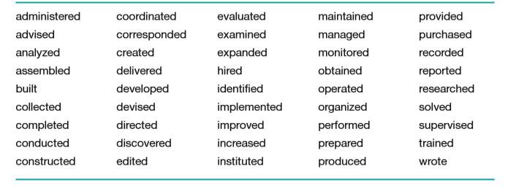
When describing positions, functions, or responsibilities, use the active voice rather than the passive voice.
Strong action verbs used in résumés:

Slide 28
Activities, interests and others
Most employers want to know about special abilities that will make an individual a more valuable employee.
Include only information that the employer will find useful, and that casts the candidate a favorable light.
Do not include activities that might create a negative impression.
Participation in community-service organizations or volunteer work in a hospital
University-sanctioned activities
Knowledge of handling special equipment
Hobbies related to your career
Sports, esp. those that might be socially useful in professional career
Languages skills (beginner, intermediate, and advanced /reading, writing and speaking abilities)
Computer skills (hardware, software, languages, and operating systems; certifications)
Awards or honors received

Slide 29
References
Those people who are willing to speak or write on your behalf are called references.
Potential employers will want to learn more about you from your professors and previous employers.
Choose only 3 or 4 people who combine the best elements of familiarity with the work and a credible position.
A reference from a celebrity who barely knows you is not as good as one from an obscure person who has worked closely with you.
Do get permission beforehand from the people listed as references.
This section should always be the last one in a résumé.
For space and privacy considerations, simply include “References available upon request” on the résumé and supply the names only when and if asked for.

Slide 30
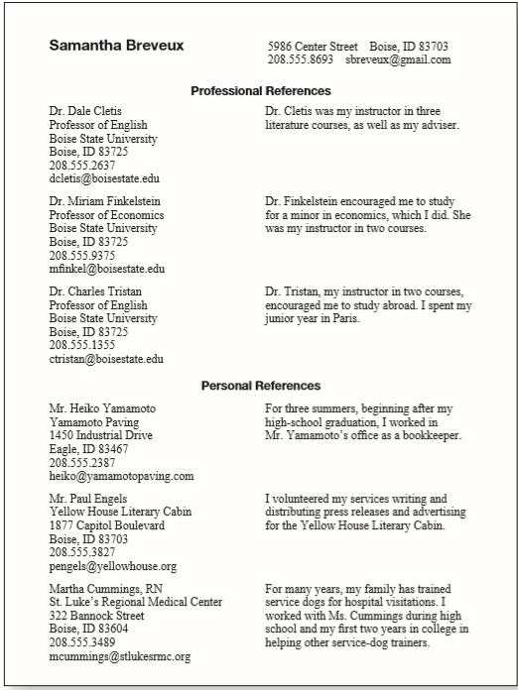
Reference page
Once having secured the references’ permission to list them, create a reference page.
This page begins with the name and contact information just as presented on the top of the résumé.
Some job applicants add, for each reference, a sentence or two describing their relationship with the reference.

Slide 31
Questions for review
Does the résumé have a professional appearance, with generous margins, a balanced layout, adequate white space, and effective indentation?
Is the résumé honest?
Is the résumé free of errors?
Does the identifying information contain your name, address(es), phone number(s), and e-mail address(es)?
Does the résumé include a clear statement of your job objectives or a summary of your qualifications?
Does the education section include your degree, your institution and its location, and your (anticipated) date of graduation, as well as any other information that will help a reader appreciate your qualifications?

Slide 32
Does the employment section include, for each job, the dates of employment, the organization’s name and location, and (if you are writing a chronological résumé) your position or title, as well as a description of your duties and accomplishments?
Does the interests-and-activities section include relevant hobbies or activities, including extracurricular interests?
Does the references section include the names, job titles, organizations, mailing addresses, and phone numbers of three or four references?
Does the résumé include any other appropriate sections, such as skills and abilities, military service, language abilities, or willingness to relocate?

Slide 33
Thank You for Attention！

